Slide 1


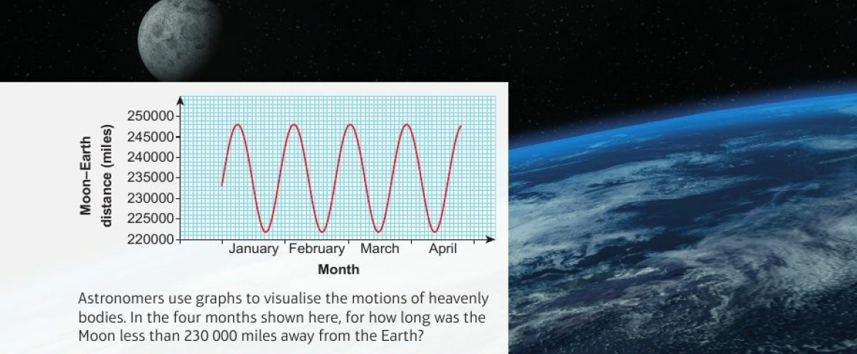
Mathematics (9-1) - iGCSE
2018-20
Year 09
Astronomers use graphs to visualize the motions of heavenly bodies in the four months shown here, for how long was the Moon less than 200,000 miles away from the Earth?
Unit 15 – Equations and Graphs

Slide 2
Contents
Page iv
15 Equations and graphs 471
Prior knowledge check 471
15.1 Solving simultaneous equations graphically 472
15.2 Representing inequalities graphically 475
15.3 Graphs of quadratic functions 478
15.4 Solving quadratic equations graphically 482
15.5 Graphs of cubic functions 485
Problem-solving 490
Checkup 491
Strengthen 492
Extend 496
Knowledge check 498
Unit test 499

Slide 3
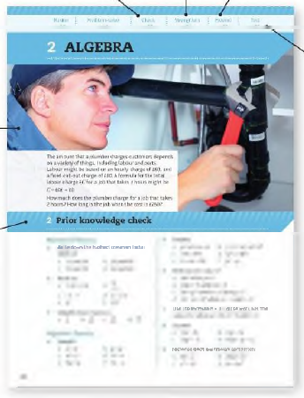
Contents
Page v
At the end of the Master lessons, take a check-up test to help you to decide whether to strengthen or Extend our learning
Extend helps you to apply the maths you know to some different situations
Unit Openers put the maths you are about to learn into a real-life context. Have a go at the question - it uses maths you have already learnt so you should be able to answer it at the start of the unit.
When you have finished the whole unit, a Unit test helps you see how much progress you are making.
Choose only the topics in strengthen thay you need a bit more practice with. You’ll find more hints here to lead you through specific questions. Then move on to Extend
Use the Prior knowledge check to make sure you are ready to start the main lessons in the unit. It checks your knowledge from Key Stage 3 and from earlier in the GCSE course. Your teacher has access to worksheets if you need to recap anything.

Slide 4
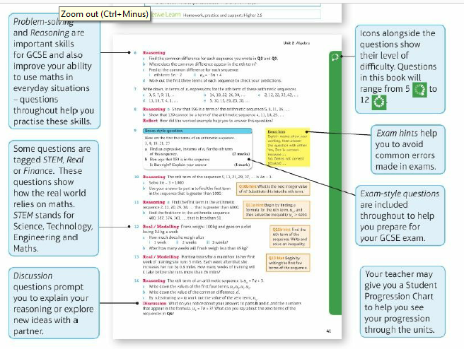
Contents
Page vi

Slide 5
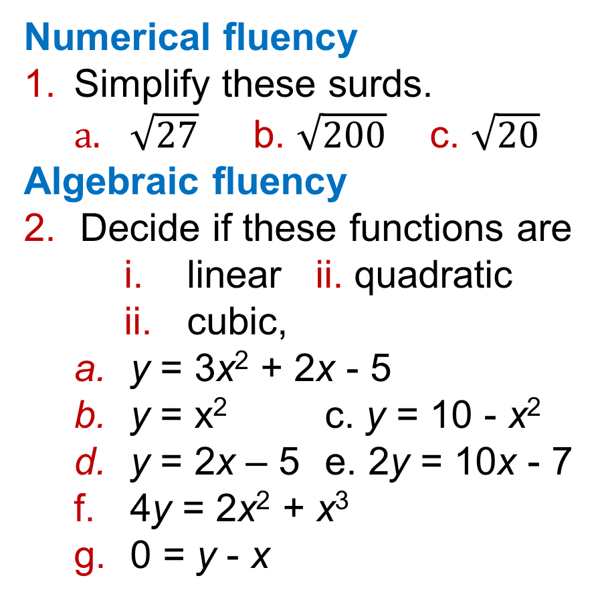
15 – Prior Knowledge Check
Page 471
Numerical fluency
Simplify these surds.
  $\sqrt{27}$ b. $\sqrt{200}$ c. $\sqrt{20}$
Algebraic fluency
Decide if these functions are
    linear ii. quadratic
    cubic,
  y = 3x² + 2x - 5
  y = x² c. y = 10 - x²
  y = 2x – 5 e. 2y = 10x - 7
  4y = 2x² + x³
  0 = y - x

Slide 6
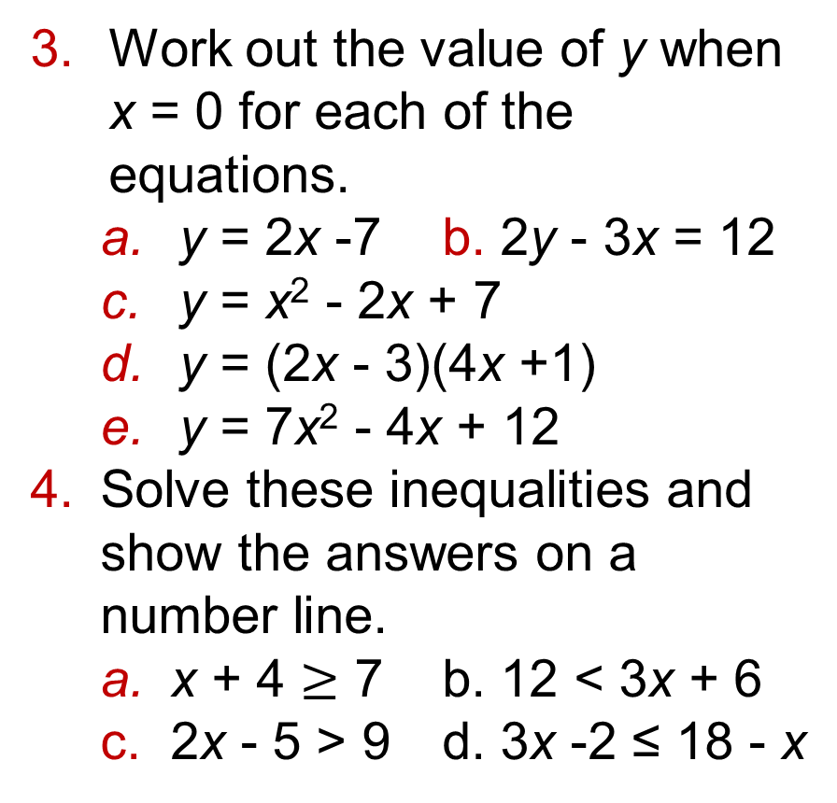
15 – Prior Knowledge Check
Page 471
Work out the value of y when x = 0 for each of the equations.
  y = 2x -7 b. 2y - 3x = 12
  y = x² - 2x + 7
  y = (2x - 3)(4x +1)
  y = 7x² - 4x + 12
Solve these inequalities and show the answers on a number line.
  x + 4 $≥$ 7 b. 12 < 3x + 6
  2x - 5 > 9 d. 3x -2 ≤ 18 - x

Slide 7
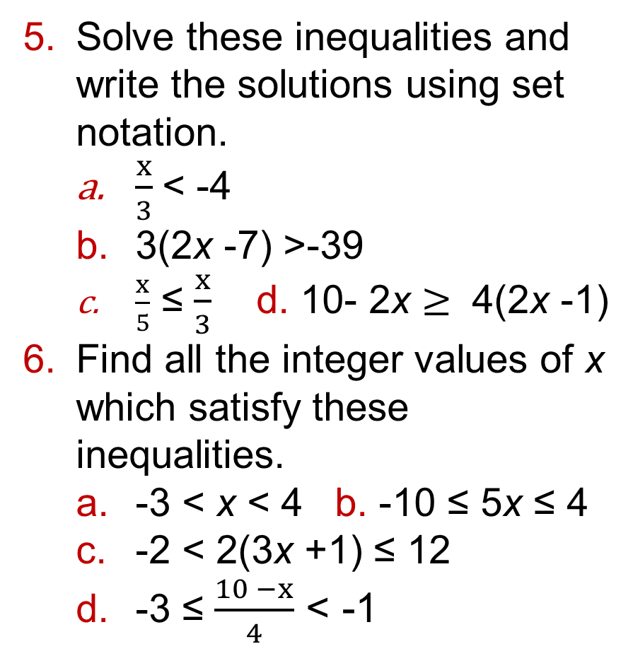
15 – Prior Knowledge Check
Page 471
Solve these inequalities and write the solutions using set notation.
  $\frac{x}{3}$< -4
  3(2x -7) >-39
  $\frac{x}{5}$ ≤ $\frac{x}{3}$ d. 10- 2x $≥$ 4(2x -1)
Find all the integer values of x which satisfy these inequalities.
  -3 < x < 4 b. -10 ≤ 5x ≤ 4
  -2 < 2(3x +1) ≤ 12
  -3 ≤ $\frac{10 −x}{4}$ < -1

Slide 8
15 – Prior Knowledge Check
Page 471
Expand and simplify,
  (x + 3)(x + 7)
  (x - 5)(x + 8)
  ((x - 3)(x - 2)
  (x – 4)² e. (2x + 3)(x + 5)
  (3x - 5)(x - 2)
  (3x + 1)(3x – 1)
Factorise
  x² + 7x + 10 b. x² - 2x - 3
  x² + 2x - 15 d. x² - 6x - 7
  x² - 1
  3x² + 15x + 12
  2x² + x - 10

Slide 9
15 – Prior Knowledge Check
Page 472
Solve the equation by factorising. 3x² + x = 10
Write in the form a(x + p)² + q
  x² - 6x +12
  x² - 8x + 11
  3x² - 6x + 9
Solve by completing the square. Put your answers in surd form where necessary.
  x² + 4x = 5
  x² + 2x = 0
  x² + 3x -5 = 0
  2x² + 4x - 6 = 0

Slide 10
15 – Prior Knowledge Check
Page 472
Solve the simultaneous equations.
  x + y = 6 b. 2x - 3y = -9
  y - x = 8 x + y = 8
  2x + y = 1
  x² + y = 4
Use the quadratic formula to find the solutions to the equations to one decimal place.
  0 = x² + 5x + 2
  6x² = 5x + 12

Slide 11
15 – Prior Knowledge Check
Page 472
Graphical fluency
a. Draw a coordinate grid with -10 to +10 on both axes.
  Plot and label the graphs of these functions by using the gradient and y-intercept.
    y = 2x + 3
    y - x = 4
    2y = 4x + 7

Slide 12
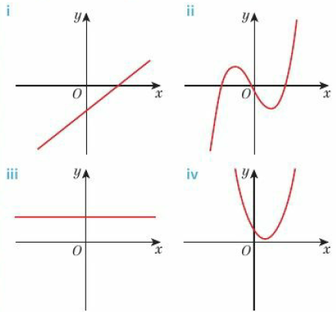
15 – Prior Knowledge Check
Page 472
Graphical fluency
Which of the graphs shown is
  linear b. quadratic
  cubic?

Slide 13
15 – Prior Knowledge Check
Page 472
Graphical fluency
a. Draw the graph of
y = x² + 3x - 4 for x values from -5 to 2.
  Use your graph to solve
    x² + 3x - 4 = 0
    x² + 3x - 4 = 2
* Challenge
The solution to a quadratic equation is x = -2 or x = 7
Write in the form ax² + bx + c three different quadratic equations with this solution.

Slide 14
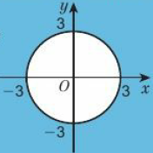
15.1 – Solving Simultaneous Equations Graphically
Page 440
Objectives |  | Did You Know?
Solve simultaneous equations graphically. |  | In 2000 BC the Chinese discovered a method for solving simultaneous equations.
Fluency
What is the equation of the graph?
ActiveLearn - Homework, practice and support: Higher 15.1

Slide 15

15.1 – Solving Simultaneous Equations Graphically
Page 472
Draw the graph of x² + y² = 25.
a. Draw a coordinate grid with - 10 to 10 on both axes. Draw the graphs of
  2y - 4x = 8 ii y - x = 6
  Write down the coordinates of the point of intersection.
  Check your answer to b by substituting the x- and y-coordinates into both equations.
Warm Up
Key Point 1
You can solve a pair f simultaneous equations by plotting the graph of both equations and finding the point(s) of intersection.

Slide 16
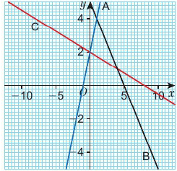
15.1 – Solving Simultaneous Equations Graphically
Page 473
Reasoning
  Match the equations to the
  three lines A, B and C shown.
    x + y = 5
    y = 2x + 2
    8 = 4y + x
  Hence write down the
  solutions to these
  simultaneous equations,
    x + y = 5 ii. x + y = 5 iii. 8 = 4y + x
    y = 2x + 2 8 = 4y + x y = 2x + 2

Slide 17
15.1 – Solving Simultaneous Equations Graphically
Page 473
  Solve the pairs of simultaneous equations by drawing the graphs,
  y = 2x + 4 y = -2x + 8
  2y = 7x - 3 x + 2y = 21
  0 = y + 2x - 5 y = 2x + 9
  2x + 3y = -13 x + y = -5
  Show that solving the equations algebraically gives the same solutions to the equations in part d.
Sara buys 4 bananas and 2 apples for £2.58. In the same shop, Alex buys 3 bananas and 3 apples for £2.49. Write a pair of simultaneous equations and solve them graphically to find the cost of
  one apple b. one banana.

Slide 18
15.1 – Solving Simultaneous Equations Graphically
Page 473
  Real / Reasoning Two broadband providers offer the following prices:
    For each company form an equation to calculate the monthly cost, with y = total monthly cost and x = GBs of data used,
    Use a graphical method to work out how many GBs of data are used if the cost for both companies is the same.
    Discussion When is Stream Speed cheaper than ONIine?
ONIine
No monthly cost
£2 per GB of data.
Stream Speed
Monthly tariff £20
£1.50 per GB of data

Slide 19
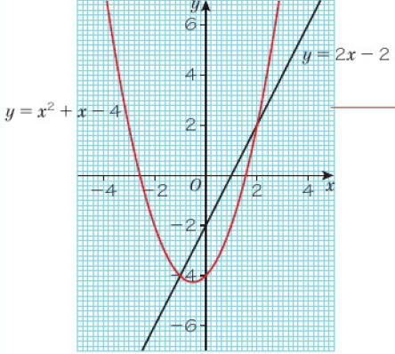
15.1 – Solving Simultaneous Equations Graphically
Page 474
Example 1
Solve the simultaneous equations graphically.
y = x² + x - 4 y - 2x + 2 = 0
y = x² + x - 4
y - 2x + 2 = 0
y = 2x – 2
The solutions are
x = 2, y = 2
and x = -1, y = -4
Construct a table of values, calculate the points and plot the graph.
x | -5 | -4 | -3 | -2 | -1 | 0 | 1 | 2 | 3 | 5
y | 16 | 8 | 2 | -2 | -4 | -4 | -2 | 2 | 8 | 16
Rearrange the equation to make y the subject.
Plot the linear graph on the same grid using the y-intercept and gradient.

Slide 20

15.1 – Solving Simultaneous Equations Graphically
Page 474
  Use a graphical method to find an approximate solution to the pair of simultaneous equations
  y + x² = 2
  y +1 = x
  Reasoning
  Solve this pair of simultaneous equations
    Graphically
    algebraically to 2 decimal places.
    3x + 2y = 5
    x² + y = 7
  Discussion Which method gives the more accurate solution? Explain.
Q7 Hint - Start by rearranging the equations, then plot the graphs.

Slide 21
15.1 – Solving Simultaneous Equations Graphically
Page 474
  a. On a suitable grid draw the graph of x² + y² = 25
    On the same grid draw the graph of y = x + 1
    What are the coordinates of the points at which the graphs intersect?
  Use a graphical method to find an estimate for the solution to the simultaneous equations x² + y² = 9 x + y = 1
  Discussion How could you check your solution?
  Reflect In Unit 9 you solved simultaneous equations using algebra. In this lesson, you solved simultaneous equations using graphs. Which method do you prefer? Why?

Slide 22
15.2 – Representing Inequalities Graphically
Page 475
Objectives |  | Did You Know?
Represent inequalities on graphs. Interpret graphs of inequalities. |  | In the novel Animal Farm by George Orwell, the Pigs declare: 'All animals are equal, but some animals are more equal than others'. Can they be right?
Fluency
Which integer values of x satisfy each inequality? x < 12 - 3 > x 3x ≥ 12 21 ≤ 2x – 1
ActiveLearn - Homework, practice and support: Higher 15.2

Slide 23
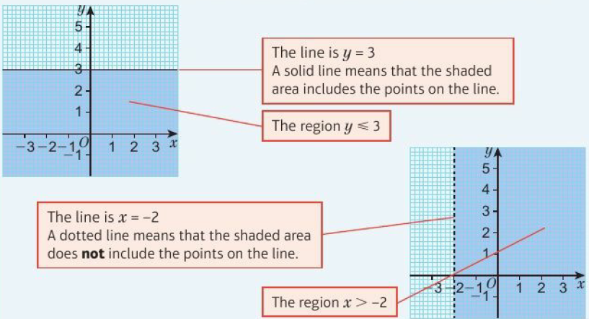
15.2 – Representing Inequalities Graphically
Page 475
  Solve the inequalities and represent the solutions using set notation,
    2x ≤ 12 b. 3x - 5 > 11 c. 3(x - 5) ≤ x - 7
Warm Up
Key Point 2
The points that satisfy an inequality such as y ≤ 3 can be represented on a graph.

Slide 24

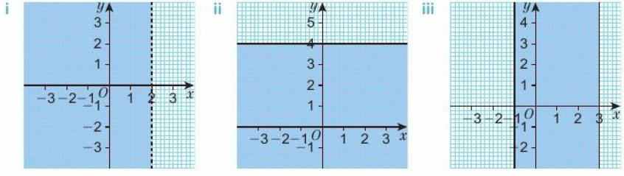
15.2 – Representing Inequalities Graphically
Page 475
  a. Write down the inequalities represented by the shaded regions
    On a suitable coordinate grid,
    shade the region of points
    whose coordinates satisfy
      x ≤ -2 ii. y > 0 iii. 4 > x iv. y – 2 < x < 1
      2 ≤ y < 3.5 vi. -5.5 ≤ x ≤ -3 vii. -4 ≤ y < -3.5
Q2b hint - 4 > x is the same as x < 4.

Slide 25

15.2 – Representing Inequalities Graphically
Page 476
  a. Draw a coordinate grid with - 5 to 5 on both axes,
    Draw the graph of y = 2x + 1
    Does the point (2, 3) satisfy the inequality y < 2x + 1?
    Shade the region of points that satisfy y < 2x + 1
Q3a hint - At the point (2,3),
y = ◻ and 2x + 1 = ◻
Q3b hint - If (2, 3) satisfies the inequality, then all points in that region will also satisfy the inequality.

Slide 26
15.2 – Representing Inequalities Graphically
Page 476
  Draw a coordinate grid with -6 to 6 on both axes.
  Shade the region that satisfies each inequality,
    y > x - 3
    y ≤ 2x - 2
    y ≥ 3x -3
    y < -x + 1
Q4 hint - Test a point to see which region satisfies the inequality.

Slide 27
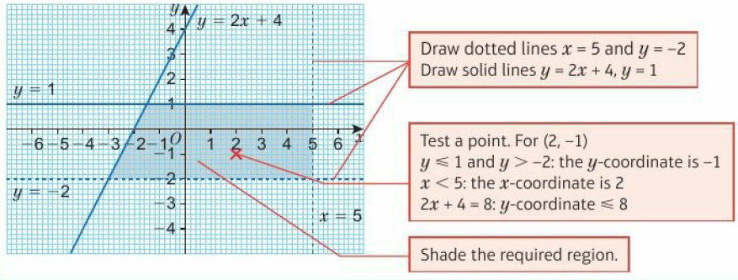
15.2 – Representing Inequalities Graphically
Page 476
Example 2
On a coordinate grid, shade the region that satisfies the inequalities x < 5, y ≤ 2x + 4, y ≤ 1 and y > -2

Slide 28
15.2 – Representing Inequalities Graphically
Page 476
  Reasoning x and y are integers.
  On a coordinate grid with -5 to 5 on both axes, mark on all the coordinates with integer coordinates which satisfy the inequalities
  y > x + 1 x ≥ -3
  y < 3
Q5 hint - Make sure you include the coordinates on the solid lines.

Slide 29
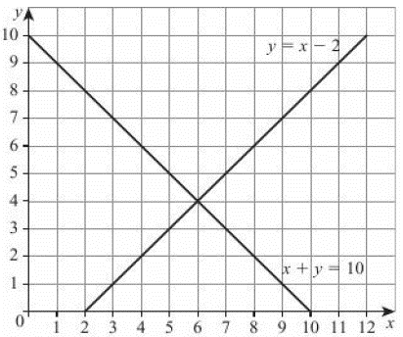
15.2 – Representing Inequalities Graphically
Page 476
14 – Exam-Style Questions
The lines y = x - 2 and
x + y = 10 are drawn on the
grid.
On the grid, mark with a
cross (X) each of the points
with integer coordinates
that are in the region defined
by y > x - 2, x + y < 10
and x > 3
(3 marks)
Nov 2012, Q17, 1MA0/1H
Exam hint
Substitute your values of x and y in the given equations to check your answers.

Slide 30
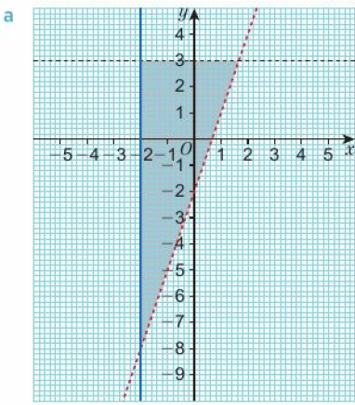
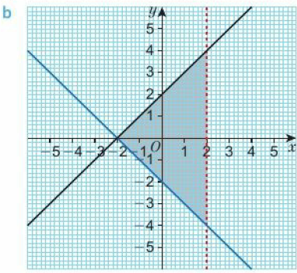
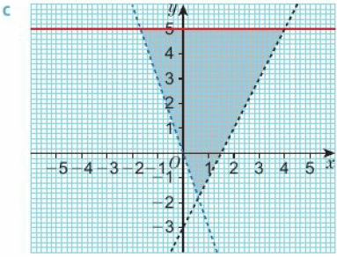
15.2 – Representing Inequalities Graphically
Page 477
  Reasoning The diagrams show a shaded
  region bounded by three lines. For each diagram
    write down the equations of the lines
    write down the three inequalities satisfied by the coordinates of the points in this region.

Slide 31
15.2 – Representing Inequalities Graphically
Page 477
  Problem-solving How many points with integer coordinates satisfy these inequalities?
    y > 2x - 3 y > -x y < 2
  a. Draw the graph of y = x² for values of x from -3 to +3.
    Draw the line y = 7 on the same axes.
    Shade the region that satisfies y > x² and y < 7
Q8 hint - You could draw a graph.

Slide 32
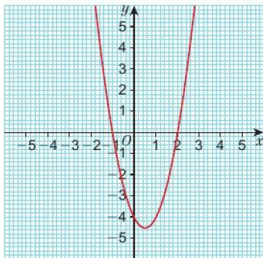
15.2 – Representing Inequalities Graphically
Page 477
  This is the graph of y = 2x² – 2x -4.
    For what integer values of x is the graph above the x-axis?
    For what integer values of x is 0 < 2x² – 2x - 4?
Q10 hint - Write your answer as two inequalities: x < ◻ and x > ◻

Slide 33
15.2 – Representing Inequalities Graphically
Page 478
Key Point 3
You can write solution sets using set notation.
The inequality x² - 9 ≥ 0 is satisfied when -3 ≤ x ≤ 3 This is written: {x : - 3 ≤ x ≤ 3}
The inequality 0 < x² - 4 is satisfied when x < -2 or x > 2 This is written: {x : x < -2} U {x: > 2}
The symbol U means that the solution includes all the values satisfied by either inequality.
  Reasoning a. Sketch the graph of y = 3x² + 3x - 6, marking clearly the points where the graph intersects the x-axis.
    From the graph identify the values of x for which 0 ≥ 3x² + 3x – 6. Give your answer using set notation.
Q11 hint - When is the graph below the x-axis? ◻ ≤ x ≤ ◻

Slide 34

15.2 – Representing Inequalities Graphically
Page 478
  Problem-solving By sketching the graph of y = 2x² + 4x - 6, find the values of x which satisfy 0 ≤ 2x² + 5x -3 Give your answer using set notation.
  Reasoning a. Sketch the graph of
  y = x² - x - 6
    Hence find the values of x which satisfy the inequality 6 < x² - x Give your answer using set notation.
  Reasoning Sketch graphs to find the values of x which satisfy these inequalities. Give your answers using set notation,
    x² + x < 12 b. 2x² ≥ 2x + 4
    X² ≥ 9
Q12 hint - Rearrange the inequality to make one side equal to 2x² + 4x - 6

Slide 35
15.3 – Graphs of Quadratic Functions
Page 475
Objectives |  | Did You Know?
Recognise and draw quadratic functions |  | The ancient Egyptians left behind a scroll showing a solution to a quadratic equation. It may be 4000 years old.
Fluency
What shape is a quadratic graph?
ActiveLearn - Homework, practice and support: Higher 15.3

Slide 36
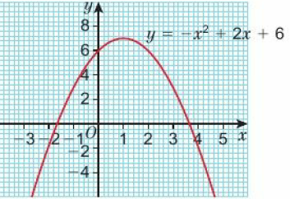
15.3 – Graphs of Quadratic Functions
Page 478
  By factorising, solve the equations
    0 – x² + 3x
    0 = 2x² + 5x - 12
  Write in the form a(x - pV * q
    x² - 2x -5 b. 2x² + 8x + 4
  Here is the graph of y = -x² + 2x + 6
    What are the coordinates of the maximum point?
    What is its line of symmetry?
Warm Up

Slide 37

15.3 – Graphs of Quadratic Functions
Page 478
Key Point 4
The lowest or highest point of the parabola, where the graph turns, is called the turning point. The turning point is either a minimum or maximum point.
The x-values where the graph intersects the x-axis are the solutions, or roots, of the equation y = 0.

Slide 38
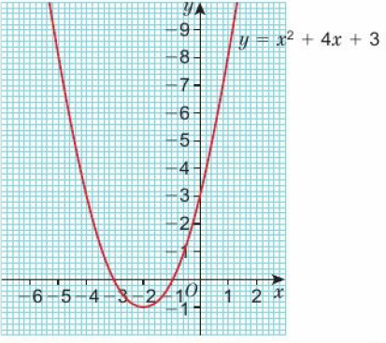

15.3 – Graphs of Quadratic Functions
Page 479
  Here is the graph of y = x² + 4x + 3
    Use the graph to find the roots of the equation x² + 4x + 3 = 0.
    Where does the graph intersect the y-axis?
    Is the turning point a maximum or a minimum?
    What are the coordinates of the turning point?
    Discussion How can you tell from the equation whether a quadratic graph will have a maximum or minimum point?

Slide 39
15.3 – Graphs of Quadratic Functions
Page 479
  a. Plot the graph of y - x² + 8x + 15
    Use your graph to find the solutions to the equation x² + 8x + 15 = 0.
    Where does the graph intersect the y-axis?
    Does the graph have a maximum or minimum point?
    What are the coordinates of the turning point?
Q6a hint - Copy and complete this table.
x | -6 | -5 | -4 | -3 | -2 | -1 | 0
y

Slide 40
15.3 – Graphs of Quadratic Functions
Page 479
  a. Solve the equations
    0 = x² + 4x + 3
    0 = x² + 8x + 15
  Find the value of y when x = 0 for the equations
    y = x² + 4x + 3
    y = x² + 8x + 15
  Discussion How can you find the roots of an equation and where a graph crosses the y-axis without drawing an accurate graph? (Compare your graphs in Q5 and Q6 with your calculations in Q7.)

Slide 41
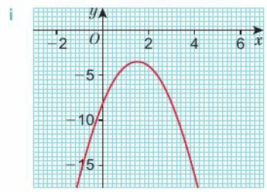
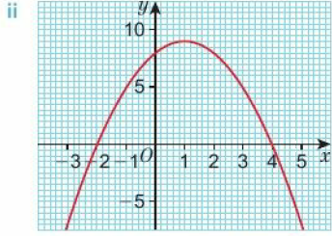
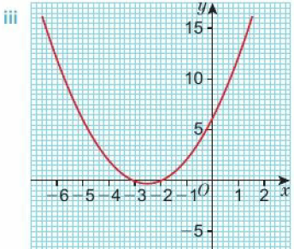
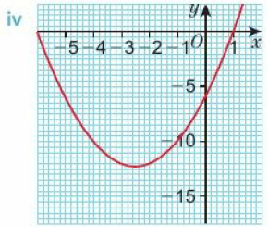
15.3 – Graphs of Quadratic Functions
Page 479
  Reasoning / Communication Match the graphs to their equations, explaining your reasoning.
    y = x² + 5x +6
    y = x² + 5x - 6
    y = -x² + 2x +8
    y = -2x² + 6x - 8

Slide 42
15.3 – Graphs of Quadratic Functions
Page 480
Key Point 5
To find the coordinate of the turning point, write the equation in completed square form: y = a(x + b)² + c
(x + b)² ≥ 0, so the minimum for y is when x + b = 0 and y = c
Example 2
Does the graph of y = x² + 8x + 15 have a maximum or a minimum point?
Find the coordinates of
the turning point.
Minimum
y = x² + 8x + 15
y = (x + 4)² – 16 + 15
y = (x + 4)² – 1
x + 4 = 0, so x = -4
Minimum at (-4, -1)
The coefficient of x² is positive, so the turning point is a minimum.
Write the quadratic function in completed square form.
The smallest value that yean take is -1. This occurs when (x + 4)² = 0. (x + 4)² cannot be less than 0 because a square is always positive. Solve the equation to find the x-coordinate.

Slide 43
15.3 – Graphs of Quadratic Functions
Page 480
  Reasoning For each quadratic function, work out the coordinates of the turning point and state whether it is a maximum or a minimum,
    y = x²- 2x + 4 b. y = -x² – 6x – 11
    y = x² – 10x + 23
    y = 2x² + 12x + 13
    y = 3x² – 12x + 13
    y = -2x² – 4x + 2
  Discussion What do you notice about the completed square form and the coordinates of the turning point?
Q9b hint – y = -(x² + 6x +11)
= -((x + 3)² + 2)
= -(x + 3)² - 2
y-coordinate of the turning point

Slide 44
15.3 – Graphs of Quadratic Functions
Page 480
  a. Factorise the expression x² - 2x - 8
    Hence write down the coordinates of the roots of y = x² – 2x - 8
    Where does the graph of y = x² – 2x - 8 cross the y-axis?
    Write x² – 2x - 8 in completed square form,
    Hence write down the coordinate of the turning point of y = x² – 2x - 8
    Is the turning point a maximum or a minimum? Explain your answer.
    Using your answers to parts a to f, sketch the graph of y = x² – 2x - 8
Q10b hint – Solve x² – 2x - 8 = 0

Slide 45
15.3 – Graphs of Quadratic Functions
Page 480
Key Point 6
When a quadratic is written in completed square form y = a(x + b)² + c the coordinate of the turning point is (-b, c)
  Use the method in Q10 to sketch these graphs,
    y = x² – 2x - 3 b. y = -x² – 2x + 8
    y = 2x² – 4x - 6 d. y = 3x² - 3
Key Point 7
To sketch a quadratic function
Calculate the solutions to the equation 'y = 0' (points of intersection with the x-axis).
Calculate the point at which the graph crosses the y-axis.
Find the coordinates of the turning point and whether it is a maximum or a minimum.

Slide 46
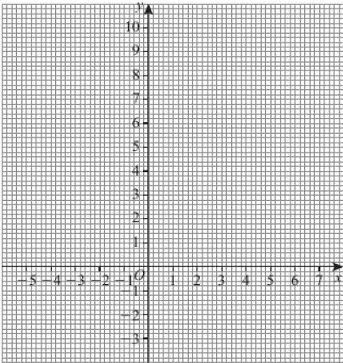
15.3 – Graphs of Quadratic Functions
Page 481
12 – Exam-Style Questions
Solve the equation
x² - 4x + 3 = 0 (2 marks)
On a copy of the grid, sketch the graph of y = x² – 4x + 3, marking clearly the coordinates of the points of intersection with the axes and the coordinates of the turning point. (4 marks)
Q12 strategy hint - You can use your answer to part a to help you draw the graph.

Slide 47
15.3 – Graphs of Quadratic Functions
Page 481
  a. Write down the coordinates of the turning point of the graph of y = (x + 3)² - 5
    Substitute y = 0 into the equation y = (x + 3)² - 5 and hence find the coordinates of the roots.
  Find the roots of these equations given in completed square form, giving your answers in surd form.
    (x + 1)² - 3 = 0
    2(x - 1)² - 18 = 0
    3(x + 2)² - 4 = 0
Q13b hint – Give your answers in surd form.

Slide 48
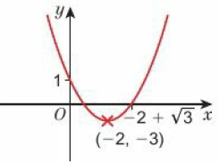
15.3 – Graphs of Quadratic Functions
Page 481
  By writing the equations in completed square form, calculate the roots of the equations. Give your answers in surd form.
    x² + 4x - 3 = 0
    2x² - 8x - 1 = 0
    3x² + 18x-12 = 0
  Problem-solving Find the equation of this quadratic graph.
Q17 hint – Substitute the value of the turning point and the y-intercept into
y = (x + 6)² + c

Slide 49
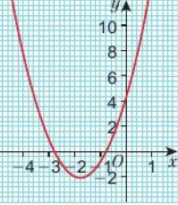
15.3 – Graphs of Quadratic Functions
Page 481
  Reasoning / Communication
  Give three reasons why the graph shown is not
  y = -2x² + 4x + 6

Slide 50
15.4 – Solving Quadratic Equations Graphically
Page 482
Objectives |  | Did You Know?
Find approximate solutions to quadratic equations graphically. Solve quadratic equations using an iterative process. |  | In 3000 BC the ancient Babylonians used quadratic equations to work out how much tax to pay.
Fluency
Will the graph of each quadratic have a maximum or a minimum point? y = 2x² + 7x - 9 • y = -3x² + 2x + 5 y = (x - 3)(x - 2) • y = (5 - x)(2 + x)
ActiveLearn - Homework, practice and support: Higher 15.4

Slide 51
15.4 – Solving Quadratic Equations Graphically
Page 482
  Find the roots of the equation by writing these equations in completed square form.
    x² + 6x + 5 = 0
    2x2+ 4x - 1=0
    3x² + 6x - 1 = 0
  Use the quadratic formula to calculate the roots of each equation. Give your answers to 1 decimal place.
    x² - 4x -7 = 0
    2x² - 3x - 4=0
    -3x² + 2x + 5 = 0
Warm Up
Q1 hint - Give your answer in surd form where necessary.

Slide 52
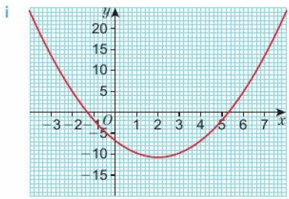
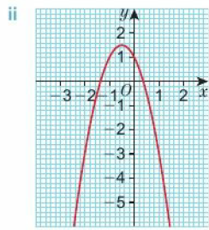
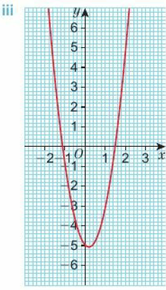
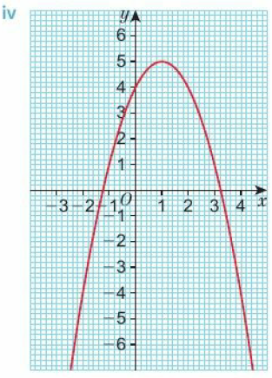
15.4 – Solving Quadratic Equations Graphically
Page 482
  Reasoning Match each graph to its equation. Hence estimate the solutions to the equations,
    x² - 4x - 7 = 0
    3x² - x - 5 = 0
    -x² + 2x + 4 = 0
    -2x² - 2x +1 = 0
Q3 hint - Work out where the graph crosses the y-axis.

Slide 53
15.4 – Solving Quadratic Equations Graphically
Page 483
  a. Copy and complete the table of values for y = 2x² - 8x + 7,
    Plot the graph of y = 2x² - 8x + 7 on a suitable grid,
    From the graph estimate the roots to the equation 2x² - 8x + 7 = 0.
  Reasoning Ali is sketching the graph of y = 2(x - 3)² + 5
  She is finding it difficult to identify the roots of the equation 2(x - 3)² + 5 = 0. Explain why.
x | -2 | -1 | 0 | 1 | 3 | 5
y |  | 17

Slide 54
15.4 – Solving Quadratic Equations Graphically
Page 483
  a. Plot the graphs of the following functions.
      y = x² + 4x - 7
      y = -x² - 3x + 2
      y = 2x² - 4x - 2
      y = -3x² + 6x + 4
    Hence estimate the solutions to the equations
      x² + 4x - 7 = 0
      -x² - 3x + 2 = 0
      2x² - 4x - 2 = 0
      -3x² + 6x + 4 = 0
    Use the quadratic formula to find the roots of the equations in part a to 3 significant figures. Check your answers to part a.

Slide 55
15.4 – Solving Quadratic Equations Graphically
Page 483
14 – Exam-Style Questions
Complete the table of values for
y = 2x² + 4x – 2 (2 marks)
Plot the graph of y = 2x² + 4x – 2
(2 marks)
Use your graph to estimate the roots of the equation 2x² + 4x – 2 = 0
(3 marks)
Write the expression 2x² + 4x -2 in the form a(x + b)² + c (2 marks)
x | -4 | -3 | -2 | -1 | 0 | 1 | 2
y
Exam hint - For greater accuracy use a ruler and draw lines on the graph to read off values.

Slide 56

15.4 – Solving Quadratic Equations Graphically
Page 483
  Reasoning For each graph
      find the coordinates of the turning point
      find the y-intercept
      sketch the graph.
    y = x² + 2x + 2
    y = -x² - 4x - 7
    y = 2x² - 4x + 3
  Discussion Do all these equations have solutions
  Reasoning Ali is sketching the graph of y = 2(x - 3)² + 5
  She is finding it difficult to identify the roots of the equation 2(x - 3)² + 5 = 0. Explain why.

Slide 57
15.4 – Solving Quadratic Equations Graphically
Page 483
  Reasoning By completing the square, decide whether these quadratic equations have
    no roots ● two roots
    one repeated root
    x² + 6x + 11 = 0
    x² + 4x - 3 = 0 c. x² - 6x - 12 = 0
    3x² + 12x + 12 = 0
    -x² + 2x - 5 = 0 f. 2x² - 8x + 5 = 0
    -2x² - 12x - 18 = 0
    -3x² - 2x + 1 = 0
Key Point 8
The quadratic equation ax² + bx + c = 0 is said to have no real roots if its graph does not cross the x-axis. If its graph just touches the x-axis, the equation has one repeated root.

Slide 58
15.4 – Solving Quadratic Equations Graphically
Page 483
14 – Exam-Style Questions
By completing the square, find the roots of the equation x² - 4x - 3 = 0, giving your answer in surd form. (3 marks)
Show algebraically that x² - 7x + 13 = 0 has no real roots.
(3 marks)
Exam hint
Write down all your working. Even if your final answer is wrong, you might still get some marks.

Slide 59
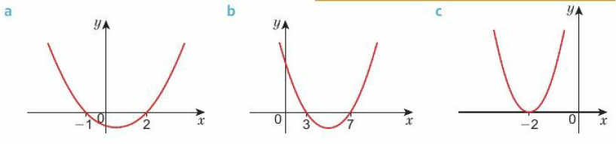
15.4 – Solving Quadratic Equations Graphically
Page 484
  Write the equation for each quadratic graph.
Q11 hint – Write y = (x –a)(x – b) and expand.
Key Point 9
To find an accurate root of a quadratic equation you can use an iterative process. Iterative means carrying out a repeated action.

Slide 60
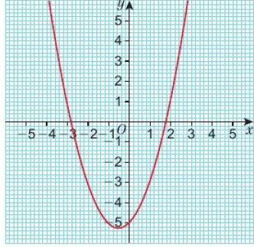

15.4 – Solving Quadratic Equations Graphically
Page 484
Example 4
Use an iterative formula to find the positive root of the equation y = x² + x - 5 to 5 decimal places.
0 = x² + x – 5
x² = 5 – x
x = $\sqrt{5 −x}$
x₁ = $\sqrt{5 −x}0$
so x_{n+1} = $\sqrt{5 −x}$_{n}
Rearrange the equation to make the highest power of x the subject.
Take the square root of each side to write x = …
Starting with initial value x₀ on the RHS gives a new value x₁. Repeating over and over again gives a sequence. So value x_{n} on the RHS gives the new value x_{n+1} on the LHS.

Slide 61

15.4 – Solving Quadratic Equations Graphically
Page 484
Example 4
x₀ = 2
x₁ = $\sqrt{5 −x0}$ = $\sqrt{5 −2}$ = $\sqrt{3}$ = 1.73200808
x₂ = $\sqrt{5 −x}1$ = $\sqrt{5 −ANS}$ = 1;807746993
x₃ = 1.786687719
x₄ = 1.792571416
x₅ = 1.790929531
x₆ = 1.791387861
x₇ = 1.791259931
x₈ = 1.79129564
x₉ = 1.791285672 = 1.79129 (5 d.p.)
x₁₀ = 1.7912885672 = 1.79129 (5 d.p.)
x = 1.79129
From the graph you can see that the positive root is approximately 2. Use this as the value of x₀
Find the value of x₂ by substituting x₁ into the iterative formula
Use the ANS key on your calculator so that the EXACT value is used.
You can use the '=' key to produce the next iteration.
Round all the answers to 5 d.p. until you get the same value twice. The answer is converging to x = 1.79129

Slide 62
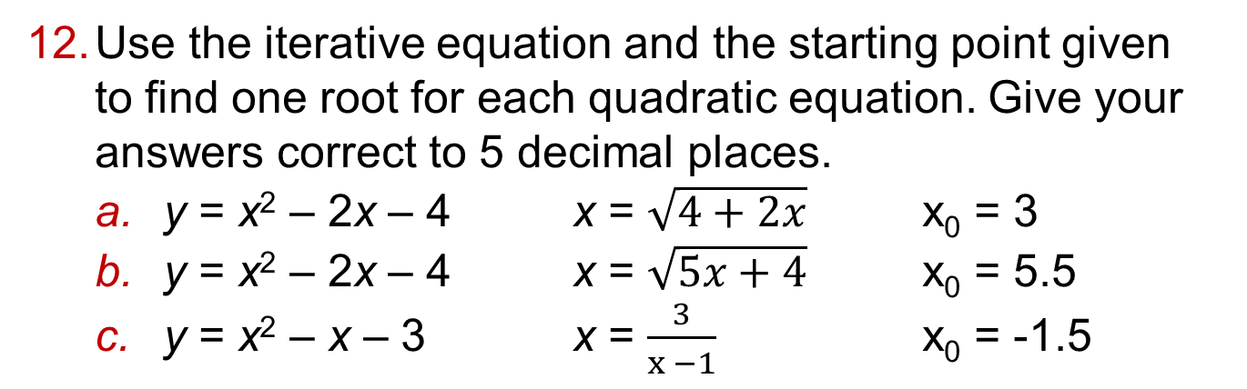
15.4 – Solving Quadratic Equations Graphically
Page 484
  Use the iterative equation and the starting point given
  to find one root for each quadratic equation. Give your answers correct to 5 decimal places.
    y = x² – 2x – 4 x = $\sqrt{4+2x}$ x₀ = 3
    y = x² – 2x – 4 x = $\sqrt{5x+4}$ x₀ = 5.5
    y = x² – x – 3 x = $\frac{3}{x −1}$ x₀ = -1.5

Slide 63
15.4 – Solving Quadratic Equations Graphically
Page 485
  a. Solve the quadratic equation x² + x - 2 = 0.
    Sketch the graph of
    y = x² + x - 2
    Write the set of values of x that satisfy x² + x - 2 < 0 (where the curve is below the x-axis)
    Write the set of values of x that satisfy x² + x - 2 > 0 (where the curve is above the x-axis)
Q13c hint - ◻ < x < ◻
Q13d hint – x < ◻ and x > ◻

Slide 64
15.4 – Solving Quadratic Equations Graphically
Page 485
Key Point 10
To solve a quadratic inequality:
Solve as a quadratic equation
Sketch the graph
Use the graph to find the values that satisfy the inequality.
  Find the set of values that satisfy each inequality.
    x² – 2x < 0
    x² + 3x – 10 < 0
    x² + 5x + 4 > 0
    x² + 7x + 10 < 0
    x² - 6x + 8 > 0
    x² - 6x + 5 < 0
Q14a hint - Solve x² – 2x - 3 = 0 first.

Slide 65
15.5 – Graphs of Cubic Functions
Page 485
Objectives |  | Did You Know?
Find the roots of cubic equations. Sketch graphs of cubic functions. Solve cubic equations using an iterative process. |  | The movements of tides can be represented by cubic equations
Fluency
Where do the graphs cross the x-axis? y = (x - 4)(x + 2) ● y = (x - 7)(x - 3) y - (x + 5)(x + 2)
ActiveLearn - Homework, practice and support: Higher 15.5

Slide 66
15.5 – Graphs of Cubic Functions
Page 485
  Expand and simplify
    (x + 2)(x + 3)
    (x - 3)(x + 4)
    (2x + 1)(x - 5)
    (3x - 4)(x - 2)
  Find the roots of each quadratic equation by factorising
    x² - 3x - 10 = 0
    x² - 1 = 0
    2x² - 4x - 6 = 0
    6x² + 10x - 4 = 0
Warm Up

Slide 67

15.5 – Graphs of Cubic Functions
Page 485
  Expand the expression
  (x² + 4x + 1)(x + 2)
  Copy and complete to expand the expression
  (x + 2)(x + 4)(x + 3)
  = (x² + ◻x + ◻)(x + 3)
  = x³ + ◻ + x² + ◻x = ◻
Q3 hint - Multiply each term in the first bracket by each term in the second bracket.
Then simplify.

Slide 68
15.5 – Graphs of Cubic Functions
Page 485
  Expand the expressions
    (x + 2)(x + 5)(x + 1)
    (x - 3)(x + 4)(x - 2)
    (x + 2)(x - 1)(x + 3)
    x(x + 5)(x - 4)
    (x + 1)²(x - 1)
    (x + 3)³

Slide 69

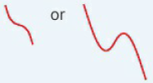
15.5 – Graphs of Cubic Functions
Page 486
Key Point 10
A cubic function is one whose highest power of x is It is written in the form y = ax³ + bx² + cx + d
When a > 0 the function looks like
When a < 0 the function looks like
The graph intersects the y-axis at the point y = d
The graph's roots can be found by finding the values of x for which y = 0.

Slide 70
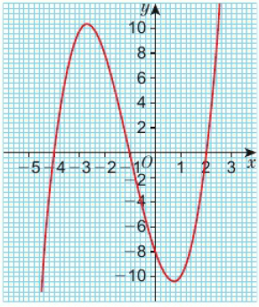
15.5 – Graphs of Cubic Functions
Page 486
  Here is the graph of y = x³ + 3x² - 6x - 8
    What are the roots of the equation x³ + 3x² - 6x - 8 = 0?
    Where does the graph cross the y-axis?

Slide 71

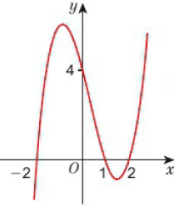
15.5 – Graphs of Cubic Functions
Page 486
Example 5
The graph crosses the y-axis when x = 0
Sketch the graph of y – (x – 1)(x – 2)(x + 2)
When x = 0, (x – 1)(x – 2)(x + 2) = -1 x -2 x 2 = 4
The graph crosses the y-axis at 4.
(x – 1)(x – 2)(x + 2) = x³ – x² – 4x + 4
The coefficient of x3 is 1, so a = 1
Since a > 1 the graph has the shape
0 = (x – 1)(x – 2)(x + 2)
x – 1 = 0
x = 1
or x – 2 = 0
x = 2
or x + 2 = 0
x = -3
Expand the expression
Find the roots of the equation
If the product of any expression is zero, one of them must itself be zero.
Sketch the graph, marking on the points of intersection with the x- and y-axis

Slide 72
15.5 – Graphs of Cubic Functions
Page 487
  a. What are the roots of the equation y = (x + 1)(x + 2)(x + 5)?
    Where does the graph of y = (x + 1)(x + 2)(x + 5) cross the y-axis?
    Sketch the graph of y = (x + 1)(x + 2)(x + 5)
Q7b hint - You could multiply the constant terms to find where it crosses the y-axis.

Slide 73
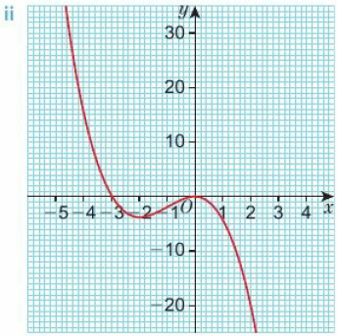
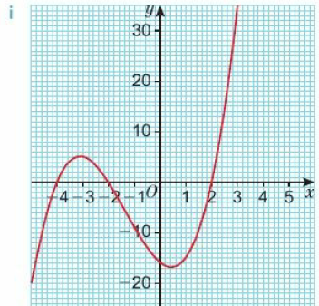
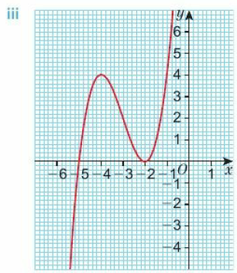
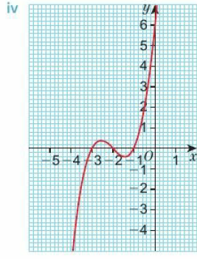
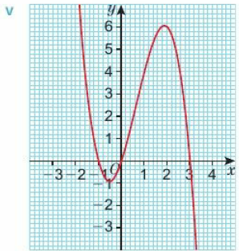
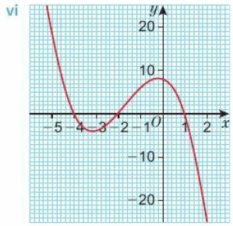
15.5 – Graphs of Cubic Functions
Page 487
  Reasoning Match the equation of each graph to its image,
    y = (x + 1)(x + 2)(x + 3)
    y = (x + 2)²(x + 5)
    y = (x - 2)(x + 2)(x + 4)
    y = - x(x + 1)(x - 3)
    y = (1 - x)(x + 2)(x + 4)
    y = - x²(x + 3)

Slide 74
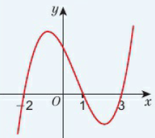
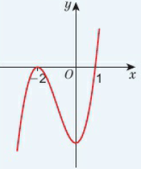
15.5 – Graphs of Cubic Functions
Page 488
Key Point 11
When the graph of a cubic function y crosses the x-axis three times, the equation y = 0 has three solutions.
For example y = (x + 2)(x – 1)(x – 3)
When the graph of a cubic function y crosses the x-axis once and touches the x-axis once, the equation y = 0 has three solutions but one of them is repeated.
For example y = (x – 1)(x - 2)²

Slide 75
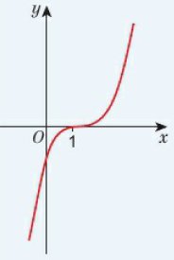
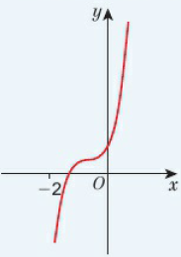
15.5 – Graphs of Cubic Functions
Page 488
Key Point 11 - cont
When the graph of a cubic function y crosses the x-axis once, the equation y = 0 can have:
One distinct repeated solution, for example y = (x - 1)³
Or only one real solution, for example (x + 2)(x² + x + 1).
The quadratic (x² - x + 1) has no real solutions.

Slide 76
15.5 – Graphs of Cubic Functions
Page 488
  How many solutions does each cubic equation have?
    (x + 1)(x - 3)(x + 4) = 0
    (x + 3)³ = 0
    -x(x + 1)(x - 3) = 0
    x²(x + 4) = 0
    (x² + 2x + 5)(x - 2) = 0
    (10 - x)(x + 4)(x - 1) = 0
  Sketch the graphs, marking clearly the points of intersection with the x- and y-axes.
    y = (x - 3)(x + 2)(x - 1)
    y = x (x + 1)(x - 4)
    y = (-x + 1)(x + 3)(x - 1)
    y = (x + 1)²(x + 3)
    y = (x + 2)³

Slide 77
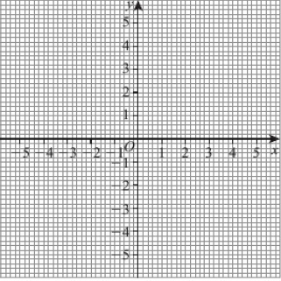
15.5 – Graphs of Cubic Functions
Page 489
11 – Exam-Style Questions
Sketch the graph of y = -x(x + 2)² marking clearly the points of intersection with the axes. (3 marks)
Exam hint
Work out the coordinates of the points of intersection of the axes before you plot them

Slide 78

15.5 – Graphs of Cubic Functions
Page 489
  Problem-solving The graph has equation y = x³ + ax²
  Work out the values of a, b and c.

Slide 79

15.5 – Graphs of Cubic Functions
Page 489
  Problem-solving A graph has equation y = -x³ + ax² + bx + c
  It crosses the x-axis at x = 1, x = 4 and x = -2.
  Without drawing the graph, work out the values of a, b and c.
  Use an iterative formula to find the negative root of the equation x³ – x² - 4x + 3 = 0 to 5 d.p.

Slide 80


15.5 – Graphs of Cubic Functions
Page 489
  Use an iterative formula to find the one root of x³ + 2x² - 6 = 0 to 4 d.p.
  The first steps
  have been done
  for you:
  x³ = -2x² + 6
  x¹ = $\sqrt[3]{−2x2+6}$
  x_{n+1} = $\sqrt[3]{−2xn2+6}$
  x₀ = ◻
  x₁ = $\sqrt[3]{−2x0+6}$ = ◻
  x₂ = $\sqrt[3]{−2x1+6}$ = ◻
Q14 hint - Estimate the root from the y-intercept on the graph.

Slide 81
15 – Problem Solving
Page 490
Objectives | Use graphs to help you solve problems
Example 6
The table shows data from a science experiment. The experiment measured the time in seconds it takes a steel sphere to fall from different heights.
Estimate the time it would take the
steel sphere to fall from 60 cm.
Look at the table. Is there a pattern in the numbers in both rows? If not, then a graph is a good problem-solving strategy.
Height (metres) | 0 | 0.25 | 0,5 | 0.75 | 1
Time (Seconds) | 0 | 0.23 | 0.32 | 0.39 | 0.45
Draw the axes for your graph. The first row in the table is usually on the horizontal axes. Decide on a scale for each axis by looking at the smallest and largest number in each row. Give your graph a title.

Slide 82

15 – Problem Solving
Page 490
Example 6
Carefully plot the points from the table.
The points lie on a curve, so join the points with a smooth curve.
The question asks for the time to fall when the steel sphere is dropped from 60cm, i.e. 0.6 m. Draw a line from 0.6m on the height axis to your graph.
Draw a line across to the time axis and read the time in seconds.
Time it would take the steel sphere to fall from 60 cm = 0.35 seconds
Check your answer against the table. Where would 0.6 m appear in the table? Would its likely time be 0.35 seconds?

Slide 83

15 – Problem Solving
Page 490
  The table shows the temperature in degrees Celsius at altitudes in 1000s of feet.
  Estimate the temperature at an altitude of 28000 feet.
  Modelling The shape of a bridge is modelled by the equation
  y = -¼x² + x + $\frac{5}{2}$, where x and y are measured in metres. How high is the highest point of the bridge?
Altitude (1000s of feet) | 15 | 20 | 25 | 30 | 35 | 40
Temperature (⁰Celcius) | 4.5 | -5.9 | -16.1 | -27.6 | -39.8 | -50.2
Q2 hint - When drawing a graph of an equation, sketch the shape first.

Slide 84

15 – Problem Solving
Page 491
  Modelling A boy throws a football upwards out of an upstairs window. The height, h, of the football, in metres, is modelled by the equation, h = 4t² + 7t + 6.5.
  At the same time, his brother fires a toy paintball gun upwards at the football on a trajectory that can be modelled by the equation h = $\frac{3}{2}$t + 2
    How high is the upstairs window?
    Show that the paint from the paintball gun hits the football. At what height does this happen?
Q5 hint – What is time, t, when the boy throws the football? What is the height at this time?
Q5 hint – Where do the graphs intersect?

Slide 85
15 – Problem Solving
Page 491
  Reasoning The table shows the ratio of median house price to median earnings for. London borough.
    Explain what the increasing ratio shows about house prices in relation to people’s earnings.
    Use the data to estimate the likely ratio in 2012.
    The ratio in 2012 was 13.87. What does this tell you about the median house price of the
    median earning in this borough?
  Reflect What clues could you look for in a question to tell you that a graph may be a good problem-solving strategy? What types of graphs could you draw?
Year | 2004 | 2005 | 2006 | 2007 | 2008 | 2009 | 2010 | 2011
Median House Price Median Earnings | 9.91 | 10.31 | 10.83 | 12.15 | 12.06 | 10.82 | 11.89 | 12.17
Q4b hint – Draw a graph.

Slide 86
15 – Check-Up
Page 491
15. Check up | Log how you did on your Student Progression Chart
  Simultaneous equations and inequalities
  Reasoning A mobile phone company offers two different packages.
    For each package, form an equation to calculate the monthly cost with y = monthly cost and x = total minutes of calls.
    Use a graphical method to work out how many minutes of calls are used if the two packages cost the same.
Package A
No monthly line rental. 10p per minute calls.
Package B
Monthly line rental £20. 5p per minute calls.

Slide 87

15 – Check-Up
Page 491
  Draw a coordinate grid with x-axis from -5 to 5 and y-axis from -5 to 11. Draw graphs to solve the simultaneous equations
  y = x² - 2x – 4 y = -x - 2
  Reasoning Write down the three inequalities satisfied by the coordinates of all the points in the shaded region of the graph.

Slide 88
15 – Check-Up
Page 491
  Graphs of quadratic functions
  a. Sketch the graph of
  y = x² + x - 12
    Showing all your workings, mark clearly the points of intersection with the y-axis, the solutions to the equation x² + x - 12 = 0 and the turning point,
    Find the set of values that satisfy x² + x -12 < 0

Slide 89

15 – Check-Up
Page 492
  a. Here is the graph of y = x² - 2x - 2.
  Showing all your workings, mark clearly the point of intersection with the y-axis and the turning point.
    Estimate the roots of the equation
    x² – 2x - 2 = 0
    Use an iterative equation to find the positive solution correct to 5 d.p.

Slide 90
15 – Check-Up
Page 492
  Graphs of cubic functions
  Showing all your working, sketch the graph of y = (x - 2)²(x + 5), marking clearly the x- and y-intercepts.
  How sure are you of your answers? Were you mostly
  Just guessing ☹
  Feeling doubtful 😐
  Confident ☺
  What next? Use your results to decide whether to strengthen or extend your learning.
  * Challenge
  A function has roots -1 and 3. List
  as many possible equations of the function as possible.
Reflect
Q8 hint - The function could be quadratic OR cubic.

Slide 91
15 – Strengthen
Page 492
15 - Strengthen
  Simultaneous equations and inequalities
  a. Copy and complete the table of values for y = x² - 3x + 1
    On suitable axes plot the graph of y = x² - 3x + 1
    On the same axes draw the graph of
    y = -x + 4
    Where do the graphs intersect one another?
    Write down the solutions for the simultaneous equations:
    y = x² - 3x +1 y = -x + 4
x | -2 | -1 | 0 | 1 | 2 | 3 | 4 | 5
y |  | 5 |  | -1
Q1e hint – Look at your answer for part d.

Slide 92
15 – Strengthen
Page 492
  The sum of two numbers is 12.
  The difference between them is 6.
  Let the numbers be represented by x and y.
    Write and equation to show their sum is 12.
    Write and equation to show their difference is 6.
    On the same grid, plot the graph of the equations you have given for parts a and b.
    Find x and y.
Q3 hint – You can always check your answer to problems like this by checking the numbers work. Do they sum up to 12? Is the difference 6?
Q3b hint – Where do the graphs intersect one another?

Slide 93

15 – Strengthen
Page 493
  Choose one inequality from each row to describe the shaded area.
  y ≤ x + 2 y < x + 2 y ≥ x + 2
  x ≤ -2 x ≥ -2
  y < -3 y > -3 y ≤ -3
Q4 hint – If the symbol is ≥ or ≤ a solid line is drawn, meaning that the points on the line itself are included.
If the symbol is < or > a dotted line is drawn, meaning that the points on the line itself are not included.
Q4 hint – Choose a coordinate in the space, for example (-3, -2)
Which of the inequalities does it satisfy?

Slide 94

15 – Strengthen
Page 492
  Solve the simultaneous equations graphically:
    y = 2x + 4 and y = -x + 7
    y = -x² + 3x + 4 and y = x + 1
  Write down
  the three
  inequalities
  that describe
  the shaded
  area;
Q2a hint – Plot both graphs on the same grid.
Q2b hint – Use the method in Q1.
Q5 hint – Write down the equation of the three lines. Use the method in Q4 to work out which inequalities describe the shaded area.

Slide 95
15 – Strengthen
Page 493
  a. Draw a coordinate grid with - 5 to 5 on both axes. Draw the line y = x.
    Mark on the coordinate (3,5).
    For this coordinate is y ≥ x?
    Mark on the coordinate (4, 3).
    For this coordinate is y ≥ x?
    Use this information to shade the area that represents y ≥ x.
Q6c hint – ≥ means greater than OR equal to.

Slide 96
15 – Strengthen
Page 493
  Use the method in Q6 to draw a graph and shade the area that represents each inequality,
    y ≤ x b. y > x c. y ≤ 2x + 2
    y > 10 - 2x
  On a suitable coordinate grid, shade the region that satisfies the inequalities x ≤ 5, x ≥ 2, y < 3, y > -x + 3
Q7a hint – Should you make the line y = x solid or dotted?
Q7b hint – Choose a coordinate to test whether y > 2x. This will show you whether to shade that side of the line.
Q9 hint – Draw the four graphs on a suitable coordinate grid.
Decide which area satisfies all four inequalities by testing coordinates.

Slide 97

15 – Strengthen
Page 493
  The diagram shows the lines y = x,
  y = -2x and y = 5 On a copy of this diagram, shade the area represented by y ≥ -2x, y > x, y < 5
Q8 hint – For each line, decide if the area to shade is above or below it. To do this, choose a coordinate pair and test it.

Slide 98




15 – Strengthen
Page 494
  Graphs of quadratic functions
  For each of these graphs write down the
    solutions to y = 0
    intercept with the
    y-axis
Find the
x values
when
y = 0
Find the
y values
when
x = 0

Slide 99
15 – Strengthen
Page 494
  A curve has the equation y = x² – 8
    When y = 0
    ____________________ = 0
    So (x - ◻ = 0)(x + ◻) = 0
    There are two possible solutions:
    x - ◻ = 0 hence x = ◻
    x + ◻ = 0 hence x = ◻
    So the roots are x = ◻ and x = ◻
    When x = 0
    y = x² + 2x – 8
    y = 0³ - ◻ - ◻
    y = ◻
  Find the roots and 0-intercept of
    x² - 2x- 15 = 0
    -x² - 6x + 16 = 0
    2x² – 4x - 6 = 0
    3x² + 12x - 15 = 0
Q3 hint – Use the method in Q2.

Slide 100

15 – Strengthen
Page 495
  Copy and complete to find the turning point of y = x² + 2x - 8
    y = (x +◻)² - ◻ - 8
    y = (x + ◻)² - ◻
    Write down the turning point of the graph y = x² + 2x - 8
    Decide if the turning point is a maximum or minimum.
Q4a hint – To find the missing term in the bracket divide the coefficient of the x term by 2.
Q4b hint – The turning point is the value of y when (x + ◻) = 0
Q4c hint –

Slide 101
15 – Strengthen
Page 495
  a. Find the coordinates of the turning point of the graphs in Q3.
    Decide whether each turning point is a maximum or minimum.
  Sketch the graphs of
    y = x² + 8x + 15
    y = -2x² + 12x - 10
Q5a hint – Use the method in Q4.
Q5b hint – Look at the coefficient of x^{2.}
Q8 hint – Find the solutions to y = 0 and the y-intercept, as in Q3.

Slide 102

15 – Strengthen
Page 495
  Sketch quadratic graphs for
    y = x² - 2x - 15
    y = - x2 - 6x + 16
    y = 2x² - 4x - 6
    y = 3x²+ 12x - 15
Q6 hint – Use your answers from Q3 and Q5 to work out these points:

Slide 103

15 – Strengthen
Page 495
  Use your sketch graph from Q6a to find the values of x that satisfy
    x² - 2x- 15 <0
    x² - 2x - 15 > 0
Q7 hint –

Slide 104

15 – Strengthen
Page 495
  For the graph of y = x² + 4x - 3 copy and complete the table of values.
    Plot the graph.
    Find the approximate roots of the equation x² + 4x - 3 = 0
x | -5 | -4 | -3 | -2 | -1 | 0 | 1 | 2
y | 2
Q9a hint – Read
the values of the
roots from your
graph.

Slide 105
15 – Strengthen
Page 495
  Plot the graphs and hence estimate the roots of
    x² - 4x + 1 = 0
    2x² - 8x + 2 = 0
    -2x² + x + 4 = 0
  a. Find an iterative formula that you could use to find the roots to the equation y = x² - 8x + 1
    Using the starting point of x² = 7.5, find the root to 3 decimal places.
Q10 hint – Use the method in Q9.
Q12 hint – Start with 0 = x² - 8x + 1 Rearrange to give x² = ◻ - ◻ Then x = .........

Slide 106


15 – Strengthen
Page 496
  a. Copy and complete to find an iterative formula to find the roots of the equation y = x² - 4x + 1
  0 = x2 – 4x + 1
  x² - 4x + 1
  x² - 4x - ◻
  x = $\sqrt{4x −\text{◻}}$
  x_{n+1} = $\sqrt{4xn −\text{◻}}$
    Use the starting point of x₀ = 3.5. Work out the values of x₁ to x₅. Work out the root to 3 decimal places.
Q10 hint – Carry on repeating the iterative process until the first four decimal places do not change.
Q10 hint – x₀ = 3.5
x₁ = $\sqrt{4 x 3.5 −\text{◻}}$ = $\text{◻}$

Slide 107

15 – Strengthen
Page 496
  Graphs of cubic functions
  For each of these graphs write down the
    solutions of the equation y - 0 ii. y-intercept

Slide 108
15 – Strengthen
Page 496
  Graphs of cubic functions
  A curve has the equation y = x³- 13x – 12. Copy and complete:
    When y = 0
    ______________________ = 0
    (x - ◻)(x + ◻)(x - ◻) = 0
    So there are three possible solutions:
    x - ◻ = 0 hence x = ◻
    x + ◻ = 0 hence x = ◻
    x - ◻ = 0 hence x = ◻
    When x = 0
    y – (x – 3)(x + 4)(x – 1)
    y = (0 – 3)(0 + 4)(◻ - ◻)
    y = ◻

Slide 109
15 – Strengthen
Page 496
  Find the roots and y-intercept of
    y = (x + 3) (x- 7) (x + 2)
    y = (10 - x)(x + 2)(x + 1)
    y = (2x - 5)(x + 2)(x - 1)
    y = (x - 3)²(3x - 6)
Q3 hint - Use the method in Q2.

Slide 110
15 – Extend
Page 496
15 - Extend
  a. Shade the region that satisfies the inequalities
  y ≤ 2x + 5 x ≤ y + 1 y ≤ -2
    Calculate the area of the shaded triangle.
  Reasoning
    What shape is made by the region that satisfies
    y ≤ x y ≥ -2x – 4 y ≥ ½x – 4
    x < 2 y ≤ 1
    What is the sum of the interior angles of this shape?
Q1a hint – Rearrange the inequality x ≤ y + 1

Slide 111
15 – Extend
Page 497
  Reasoning Calculate the exact area of the region satisfied by the inequalities
  x² + y² ≤ 30 x ≥ 0 y ≥ 0
  Reasoning Work out how many real roots each equation has.
  Show your workings.
    x² + 2x + 1 = 0
    x² + 2x+ 3 = 0
    x² – 1 = 0x
    X² + 5x + 7 = 0
    10 + 3x - x² = 0
    -x² - 2x - 3 = 0

Slide 112
15 – Extend
Page 497
  Reasoning a. Write down a quadratic function with
      a maximum at (-3, 4)
      a minimum at (4, -3)
    Write down a quadratic equation with roots at x = -3 and x = 0
6 – Exam-Style Questions
A is a curve with equation y = x² + 4x - 3 B is a line with equation y = 2x +5
A intersects B at the points P and Q.
Work out the exact length of the straight line PQ. (6 marks)
Exam hint
Read the question carefully. What do you need to work out first?

Slide 113
15 – Extend
Page 497
  a. Expand the expression
  x(x + 4)(x + 2)(x - 1)
    How many roots does the equation x(x + 4)(x + 2)(x -1) = 0 have?
8 – Exam-Style Questions
Show that x² - 4x = x(x - 2)(x + 2)
(2 marks)
Exam hint
‘Show that' means you must write down each stage of your working dearly.

Slide 114
15 – Extend
Page 497
  a. Expand the expression
  x(x + 4)(x + 2)(x - 1)
    How many roots does the equation x(x + 4)(x + 2)(x -1) = 0 have?
8 – Exam-Style Questions
Show that x² - 4x = x(x - 2)(x + 2)
(2 marks)
Exam hint
‘Show that' means you must write down each stage of your working dearly.

Slide 115
15 – Extend
Page 497
  Problem-solving / Communication - The general term of a sequence is -n² + 4n + 20. Explain why the largest term in the sequence occurs at n = 2.
  Problem-solving Where do the graphs of y = (x + 1)(x - 3)(x - 5) and y - x = 15 intersect each other.
Q9 strategy hint - Consider the graph of y = -n² + 4n + 20

Slide 116

15 – Extend
Page 497
  Expand the expression
  (x² + 2x + 1)(x² + x + 2)
  Reasoning Use a graphical method to find approximate solutions to each pair of simultaneous equations.
    x² + y² = 18 y = x² + 3x + 2
    y = $\frac{1}{x}$ y = 4x - 1
    y = x² - x - 6 y = x² +16
  Reasoning How many whole number pairs of coordinates satisfy the inequalities
  y ≥ x² - 4x – 16 and y < -15?
Q11 hint - Multiply each term in the second bracket by x², then 2x, then 1.

Slide 117

15 – Extend
Page 497
  Use a graphical method to find approximate solutions to each pair of simultaneous equations. Give all the solutions for values of x between 0 and 360°.
    y = sin x y = 0.6
    y = tan x y = 0.2
  Discussion How could you check your answers to Q14?
  Find the set of values of x that satisfy
    a 2x² - x - 3 < 0
    -x² + 3x +10 > 0
Q15b hint –

Slide 118
15 – Knowledge Check
Page 498
15 – Knowledge Check
You can solve a pair of simultaneous equations by plotting the graphs and finding where they intersect one another. The points that satisfy an inequality can be represented on a graph by shading the area to one side of the line. A dotted line is used to indicate < or > A solid line is used to indicate ≥ or ≤ A set of values that satisfy an inequality can be described using set notation, e.g. {x: x > 3} ∪ {x < - 2} or {x: - 2 ≤ x ≤ 3} The graph of a quadratic function is a smooth curve called a parabola. The lowest or highest point of the parabola, where the graph turns, is called the turning point. The turning point is either a minimum or maxim um point. The x-values where the graph intersects the x-axis are the solutions, or roots, of the equation y = 0. To find the coordinate of the turning point, write the equation in completed square form: y = a(x + b)² + c.
Mastery
Lesson 15.1
Mastery
Lesson 15.2
Mastery
Lesson 15.2
Mastery
Lesson 15.3
Mastery
Lesson 15.3

Slide 119
15 – Knowledge Check
Page 498
15 – Knowledge Check
When a quadratic is written in completed square form y = a(x + b)² + c the coordinate of the turning point is (-6, c). To sketch a quadratic function Calculate the solutions to the equation y = 0 (points of intersection with the x-axis). Calculate the point at which the graph crosses the y-axis. Find the coordinates of the turning point and whether it is a maximum or a minimum. The quadratic equation ax² + bx + c = 0 is said to have no real roots if its graph does not cross the x-axis. If its graph just touches the x-axis, the equation has one repeated root. To find an accurate root of a quadratic or cubic equation you can use an iterative process. Iterative means carrying out a repeated action. To solve a quadratic inequality, solve as a quadratic equation then sketch the graph. Use the graph to find the values that satisfy the inequality.
Mastery
Lesson 15.3
Mastery
Lesson 15.3
Mastery
Lesson 15.4
Mastery
Lesson 15.3
Mastery
Lesson 15.5

Slide 120
15 – Knowledge Check
Page 498
15 – Knowledge Check
To expand three pairs of brackets, first expand 2 of the brackets. A cubic function is one whose highest power of x is x³. It is written in the form y = ax³ + bx² + cx + d The graph intersects the y-axis at the point y = d. The graph’s roots can be found by finding the values of x for which y = 0. When the graph of a cubic function y crosses the x-axis three times, the equation y = 0 has three solutions. When it crosses once and touches once it has three solutions but one is repeated. When it crosses once it can have one distinct, repeated solution or only one real solution. In this unit, which was easiest, and which was hardest, to work with: Graphs for solving simultaneous equations? Graphs of inequalities? Graphs of quadratic functions? • Graphs of cubic functions? Copy and complete these sentences. I find graphs _________ easiest, because______________________ I find graphs _________ hardest, because______________________
Mastery
Lesson 15.5
Mastery
Lesson 15.5
Mastery
Lesson 15.5
Reflect

Slide 121
15 – Unit Test
Page 488
15 – Unit Test | Log how you did on your Student Progression Chart.
Use a graphical method to solve the simultaneous equations
2y = x - 8 y = 8 – x (4 marks)
Draw a coordinate grid with -10 to +10 on both axes.
Shade the area that satisfies the inequalities y - 2x < 7 and y > 4
(3 marks)
Sketch the graph of
y = x² - 4x -1 (3 marks).

Slide 122




15 – Unit Test
Page 499
Reasoning / Communication Match the equations
to their graphs. Explain your reasoning. (4 marks)
  y = x² - 4x + 4
  y = (x - 3)(x + 1)
  y = -x² + 5x+ 6
  y = (2 - x)² – 3

Slide 123
15 – Unit Test
Page 499
Reasoning Write down the equation of a graph with a maximum point at (3, -4).
(3 marks)
Reasoning Calculate the exact area satisfied by the inequalities x² + y² ≥ 25, x ≤ 5 and y ≤ 5.
(4 marks)
Problem-solving A is the graph of y = x² - 3x + 5.
B is the graph of y - x = 5. The graphs intersect at points P and Q. Find the length of PQ. Give your answer as a surd. (6 marks)

Slide 124

15 – Unit Test
Page 499
Find the values of x that satisfy x² + x - 6 > 0 (5 marks)
Reasoning Which of these equations has real roots?
  x² - 6x + 13 = 0
  2x² + 4x- 5 = 0
  -x² – 4x + 9 = 0 (5 marks)
Use an iterative formula to find the only real solution to
x² - x + 8 = 0
to 5 d.p.
(5 marks)

Slide 125

15 – Unit Test
Page 500
Exam-Style Questions
The graph of y = x² + bx + c is
shown on the grid.
Work out the value of b and the value of c. (4 marks)
Student A answer
Where x = 0, y= 13
13 = 0² + 0 + c
c= 13
b= -3 since the smallest value of y is when x = -3
Student B answer
The turning point is at (-3,4)
y = (x + 3)² +4
y = x² + 6x + 9 + 4
y = x² + 6x + 13
b = 6, c = 13
Student C answer
The turning point is at (-3, 4).
y = (x + 3)(x - 4)
y = x² + 3x - 4x - 12
y = x² - x-12
B = -1, c= -12

